Slide 1
Introduction to LangChain
Pascal Simon
2024/03

Slide 2

Agenda
LLM-powered applications
langchain overview
Key components of langchain
Setting everything up
Examples

Slide 3

LLM-Powered Applications
< 1 >

Slide 4
LLMs are just models processing numbers
LLM = large language model, is a machine learning model able to output text based on text input
Or simplified
Calculate embeddings
Model
Predicts
lookup
Text
Vectors of floats
Next token
Text
Prompt
LLM
Answer

Slide 5
LLM vs traditional ML model
‘Traditional’ machine learning model
Number of parameters to train in the order of 1000’s to millions
Models need to be trained from scratch input-features are specific to problem
GPU benefitial for efficient training.
Inference is very fast, no special hardware required.
Large language model
Number of parameters in the billions (e.g. Llama2->80 b, GPT4 supposedly > 1 trillion)
Models are pre-trained, can be applied to many problems without any fine-tuning
Multiple servers required for training
Inference also requires GPU with lots of memory, and is still slow

Slide 6
LLM as an API
Traditional application
Application using LLM
API
LLM
REST calls
Latency ~some ms
Tokenization
Embedding
Latency ~seconds
Json msg
Plain text msg
Application
Application
Plan / Reasoning wired in code
Plan / Reasoning partially outsourced to LLM

Slide 7
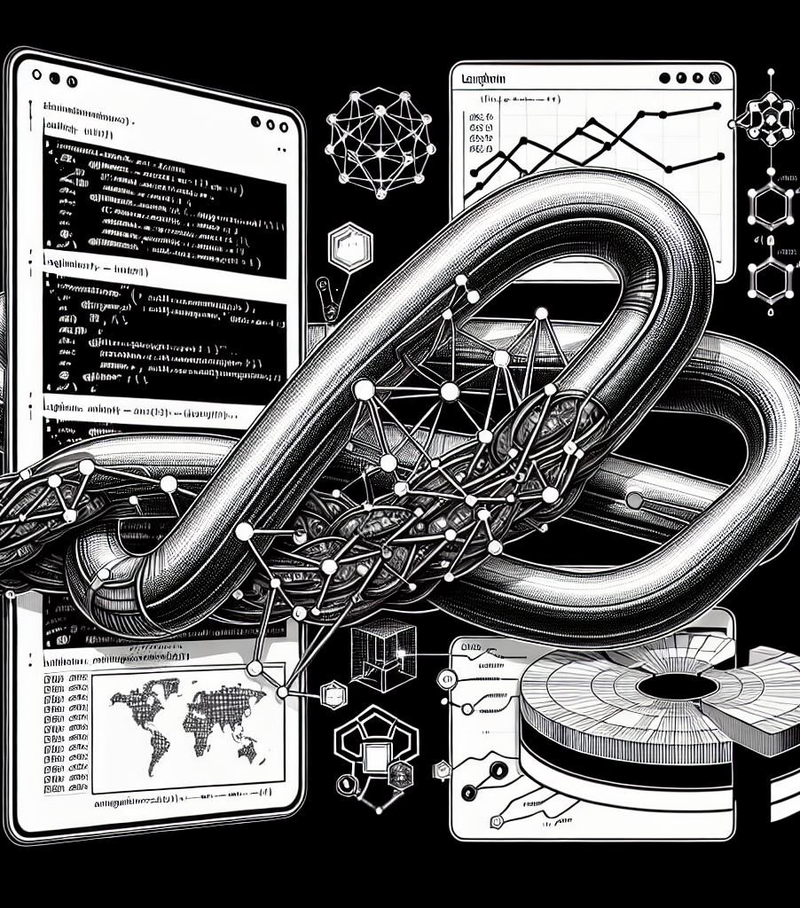
langchain overview
<2>

Slide 8
What is LangChain?
Python-based framework
Aims to accelerate and simplify building applications based on LLMs
New project that gained very quick adoption (1st release Oct 22, as of March 24 it’s 0.1.11)
Seems to become de-facto standard for building LLM-based (prototype) apps
Also well known project LlamaIndex provides substitution for some functionality of LangChain, but is not a replacement

Slide 9
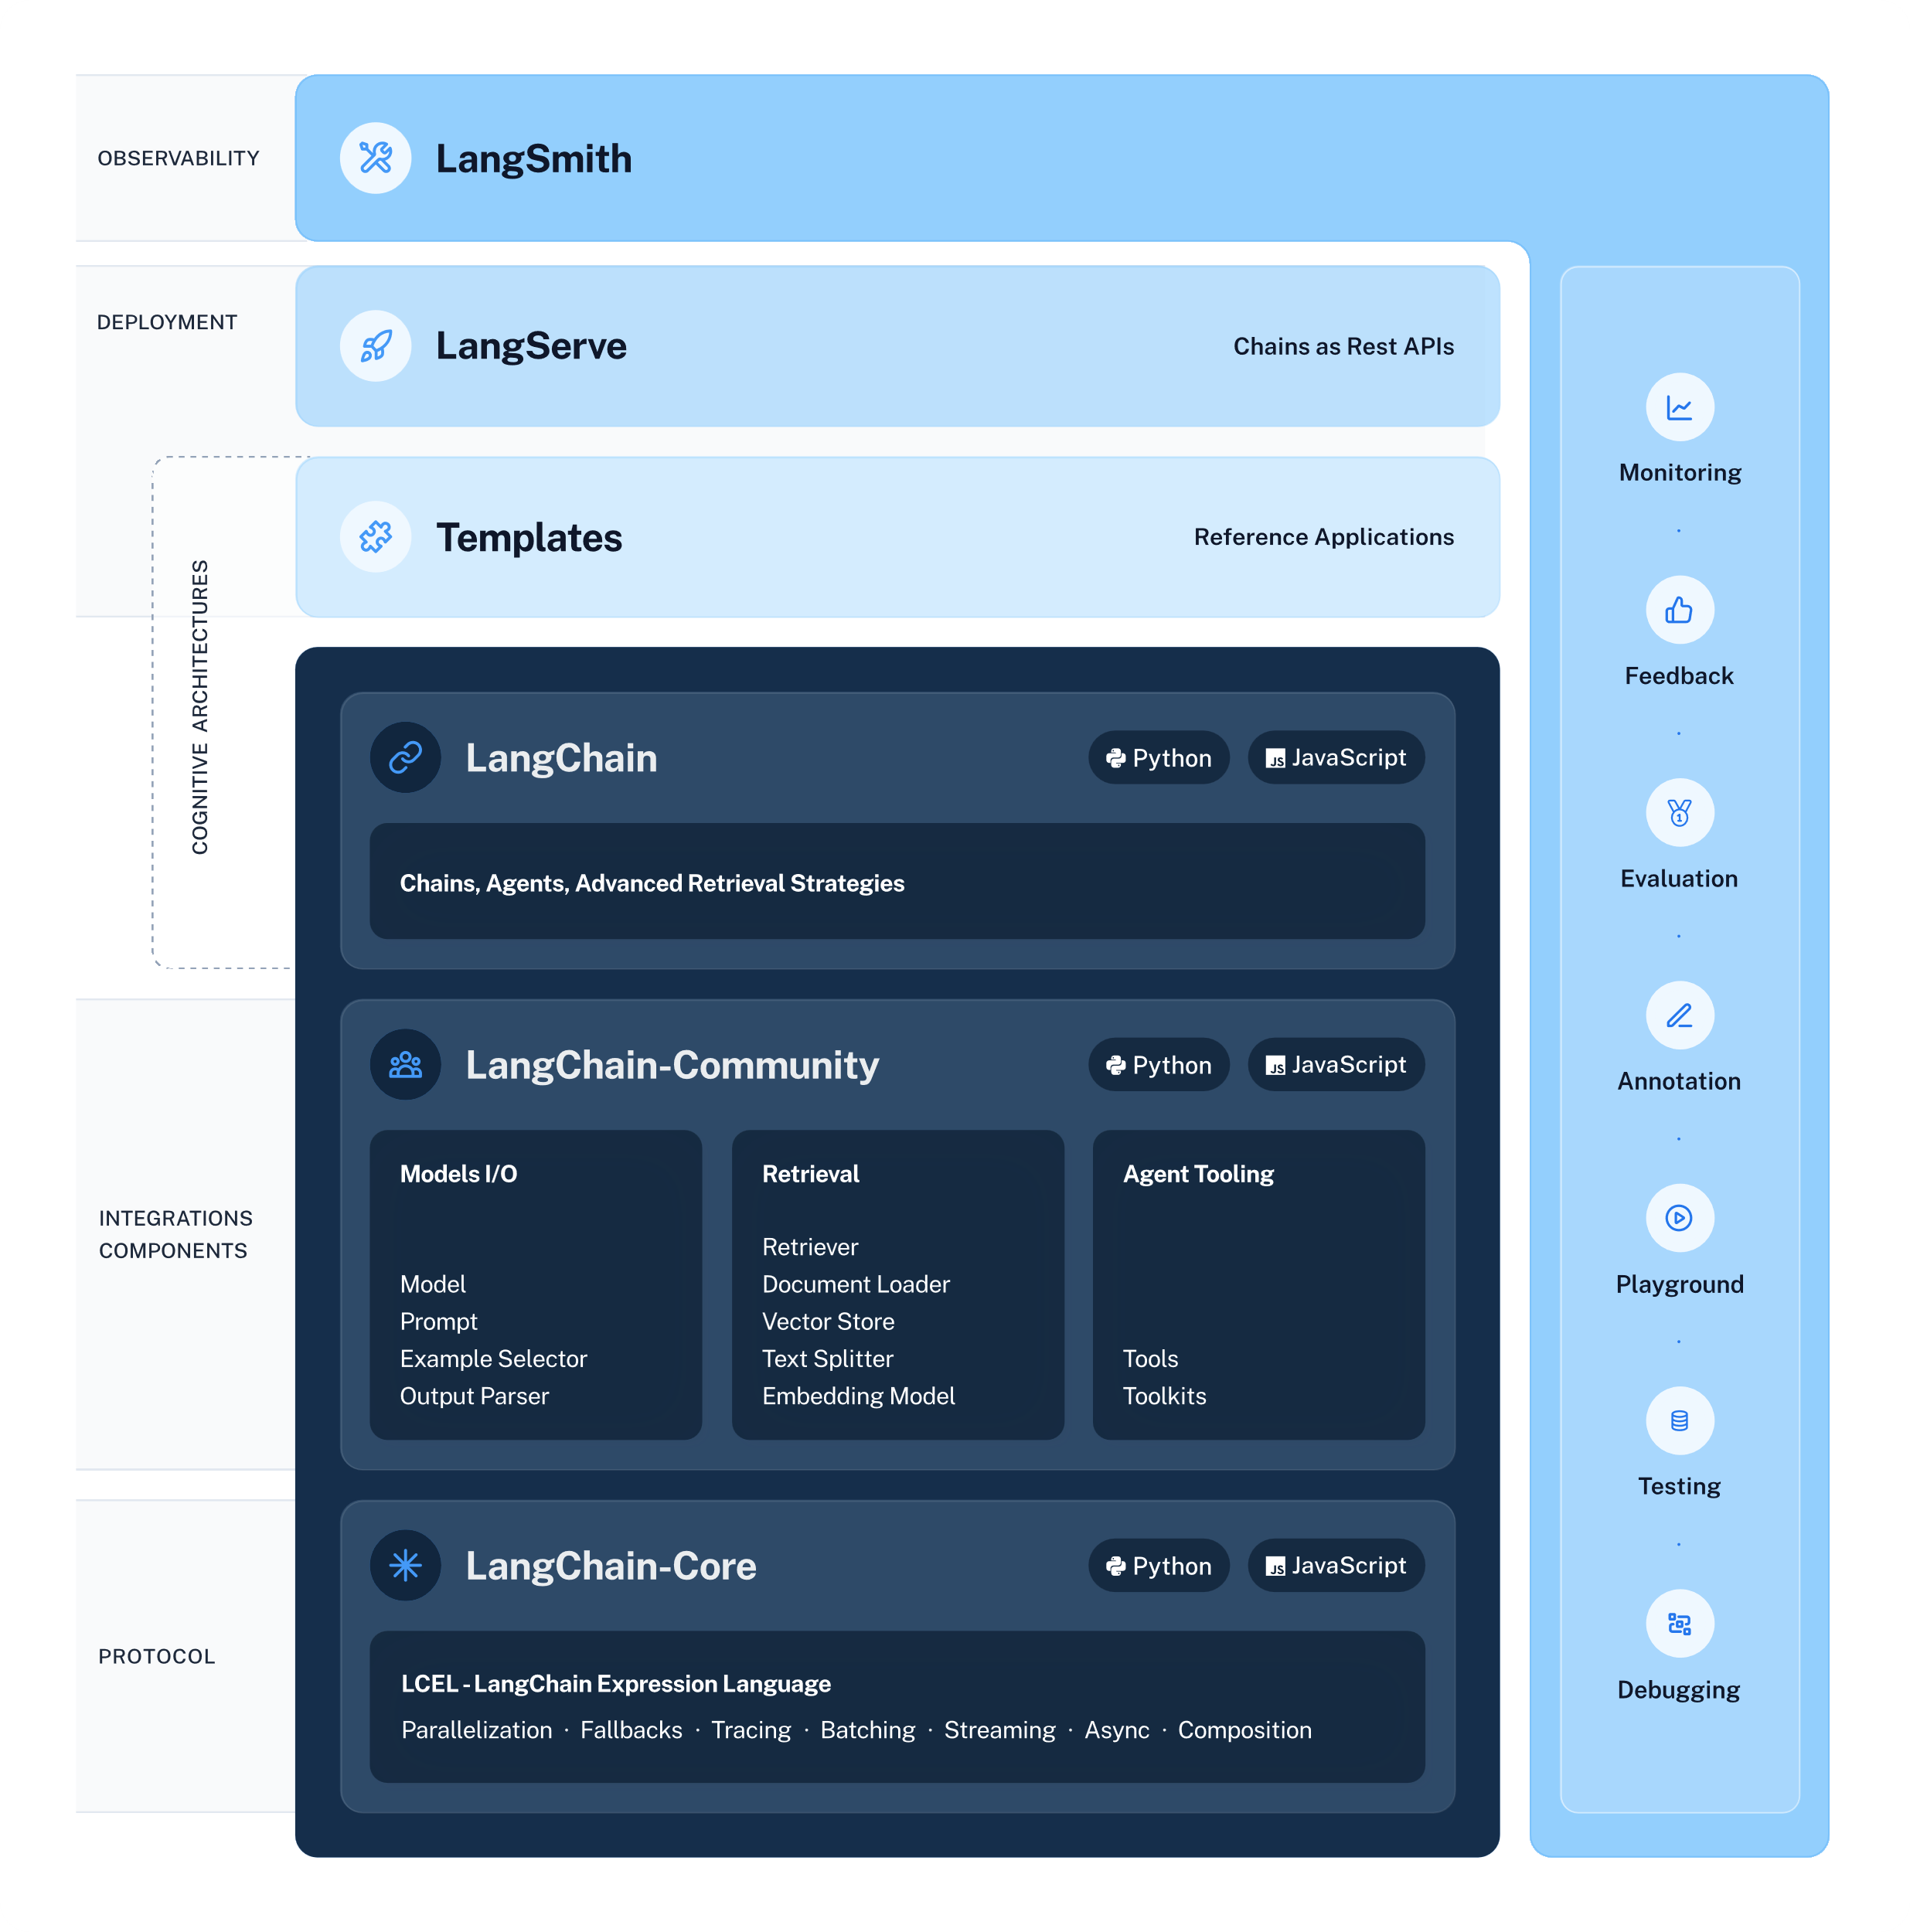
https://python.langchain.com/docs/get_started/introduction

Slide 10

Key components of langchain
<3>

Slide 11
Chains: where LangChain got its name from
Chains are an abstraction of a fixed workflow, taking some input, feeding it to an LLM and processing the output
LangChain introduces an expression language (LCEL) that allows elegant chain definition
See sample code: main_recipe_generator.py
model = ChatOpenAI()
prompt = ChatPromptTemplate.from_template("tell me a joke about {topic}")
chain = prompt | model
chain.invoke({"topic": "bears"})
chain = (
RunnablePassthrough()
| prompt_template
| model
| StrOutputParser()
)

Slide 12
Adding dynamic behavior: Agents
Program flow in a chain is fixed. An agent allows for adaptive flow
Agents require an overall goal, tools and an LLM
Idea: The agent reasons using an LLM how to reach a goal and which tools to use and dynamically generate actions
agent = create_react_agent(llm=model, tools=tools, prompt=prompt)
agent_executor = AgentExecutor(agent=agent, tools=tools, verbose=True, handle_parsing_errors=True) agent_executor.invoke({
"period": "June",
"destination": "Thailand",
"type": "scuba diving"
})

Slide 13
Adding capabilities with Tools & Toolkits
Tools are used to integrate virtually any functionality. E.g.:
Shell: allows running shell commands
TavilySearchResults: Web-search
WikipediaQueryRun: Search Wikipedia
YouTubeSearchTool: Search youtube videos, incl. metadata and transcriptions
BearlyInterpreterTool / PythonREPL: Runs code
WolframAlphaAPIWrapper: Solves complex math
Toolkits are collections of tools (E.g. SqlDatabaseToolkit)
from langchain_community.tools.tavily_search import TavilySearchResults
tools = [TavilySearchResults()]

Slide 14
Retrievers & Stores
If the application should work with a specific data source (like company knowledge), a data store is needed
Retrievers connect a datastore to chains and agents
For example:
FAISS: Easy to use in-memory vector store
BM25Retriever: Full text search using BM25 algorithm
LOTR: Lord of the retrievers: combines multiple retrievers

Slide 15

Setting everything up
<4>

Slide 16
Create an environment, install langchain
Create and activate virtual environment
conda create –n “langchain_starter”
conda activate langchain_starter
Install langchain (will install compatible Python version as well)
pip install langchain langchain-openai python-dotenv langchainhub
Optionally
pip install langchain-experimental
Additional packages depending on the tools you want, e.g.
pip install wolframalpha

Slide 17
Store your secrets
Most modules can read secrets and other configuration from the OS environment
Can use python-dotenv module to load these from a local .env text file
E.g.:
Load with
from dotenv import load_dotenv
load_dotenv()
BEARLY_API_KEY=“…"
WOLFRAM_ALPHA_APPID =“…"
AZURE_OPENAI_API_KEY=“…"
AZURE_OPENAI_ENDPOINT="https://openai3032.openai.azure.com/"
AZURE_EMBEDDING_DEPLOYMENT="ADA2"
OPENAI_API_VERSION="2023-12-01-preview"
AZURE_GPT3_DEPLOYMENT="GPT35"
AZURE_GPT4_DEPLOYMENT="GPT4"

Slide 18
Using Azure OpenAI
Azure provides OpenAI’s GPT 3.5 and 4 models
Go to portal.azure, section Azure Open AI (only accessible from Viseca network if you use your VS subscription)
Create resource group (CH-north works)
You will initialize need to fill out request form, usually approved withing 24 hours
Deploy the models you want
Store the deployment names, deployment URL and the API key in your .env file

Slide 19
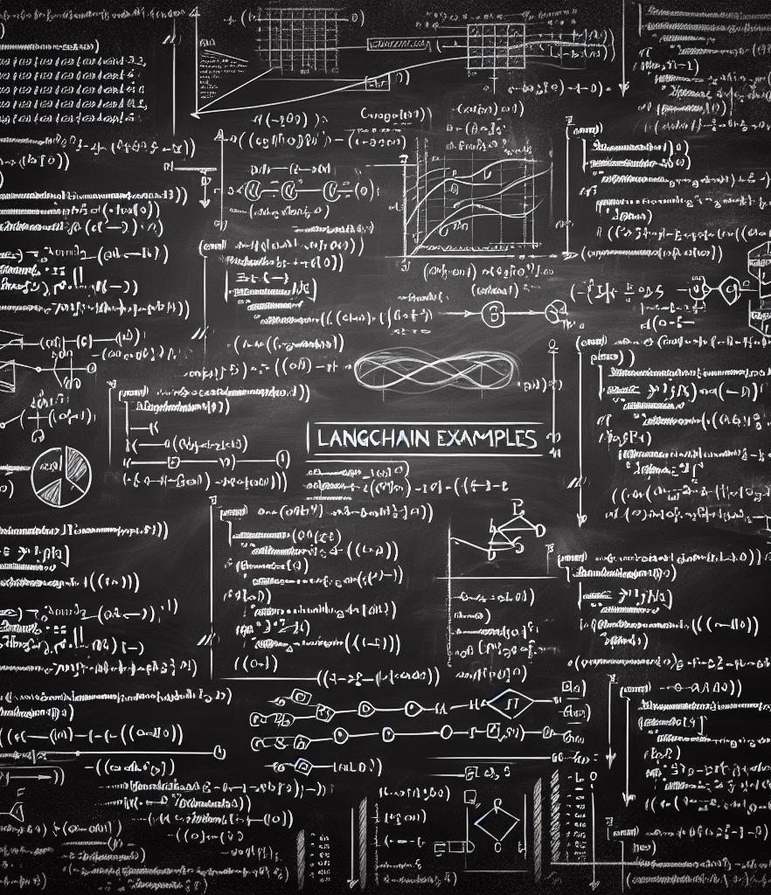
Examples
<5>

Slide 20
Practical Use Cases
LangChain can be applied in various scenarios, such as:
Automating code generation and review.
Enhancing chatbots with advanced contextual understanding.
Building intelligent data analysis tools.

Slide 21
Sample code
Simple chain:
main_recipe_generator.py
Complex react-agent with tools:
main_math.py
Agent with internet search:
main_travel_agent.py
Code is published here: https://github.com/ps78/langchain_starter

Slide 22
Thank you Pascal Simon https://github.com/ps78

